Slide 1

Critical thinking

Slide 2
CRITICAL THINKING
Good tests kill flawed theories; we remain alive to guess again.
- Karl Popper

Slide 3
What is Critical Thinking?
ability to think clearly and rationally
understand the logical connections between ideas
identify, construct and evaluate arguments
detect inconsistencies and common mistakes in reasoning
solve problems systematically
identify the relevance and importance of ideas
reflect on the justification of one's own beliefs and values

Slide 4
Critical Thinking – How?
Remember | Understand | Apply | Analyze | Evaluate | Create
Recognizing | Interpreting | Implementing | Comparing | Checking | Designing
Listing | Exemplifying | Carrying Out | Organizing | Hypothesizing | Constructing
Describing | Summarizing | Using | Deconstructing | Critiquing | Planning
Identifying | Inferring | Executing | Attributing | Experimenting | Producing
Retrieving | Paraphrasing | Doing | Outlining | Judging | Inventing
Naming | Classifying |  | Structuring | Testing | Devising
Locating | Comparing |  | Integrating | Detecting | Making
Finding |  |  |  | Monitoring | Building

Slide 5
Critical Thinking - Unplugged
Sr No | Module Name | Critical Thinking Activity Description | Action Verb | Outcome
1 | Human Minds and Robots |  | Comparing
2 | Algorithms |  | Listing
3 | Flowchart |  | Listing
4 | Importance of Senses, Human Sensory Organs vs Robots |  | Experimenting
5 | Distance, Time & Speed |  | Devising
6 | Relationship between Physics & Robotics |  | Critiquing
7 | Artificial Intelligence |  | Recognizing, Classifying

Slide 6
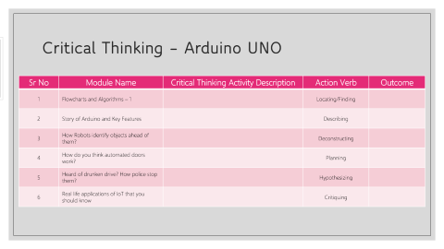
Critical Thinking – Arduino UNO
Sr No | Module Name | Critical Thinking Activity Description | Action Verb | Outcome
1 | Flowcharts and Algorithms – 1 |  | Locating/Finding
2 | Story of Arduino and Key Features |  | Describing
3 | How Robots identify objects ahead of them? |  | Deconstructing
4 | How do you think automated doors work? |  | Planning
5 | Heard of drunken drive? How police stop them? |  | Hypothesizing
6 | Real life applications of IoT that you should know |  | Critiquing

Slide 7
Critical Thinking Activity Structure
Objective
Student Learning Outcome in terms of Critical Thinking
Resources
Why this activity?
Checkpoints
Bright Spots
Graphics Organizer (Suitable to Activity)
Reflection Point
NOTE: Checkpoints will be a series of questions which will give facilitator feedback about understanding level of students

Slide 8
THANK YOU

